Slide 1
Machine Learning and Artificial Intelligence
Notes:
First of all, welcome.
This course is: An introduction to machine learning.
I’m Dan and it looks like I’ll be with you in these recorded lectures for the next 15 weeks or so. That’s a lot of listening/watching for you and a lot of talking/filming for me, so I’ll try to keep this one-sided conversation as interesting as I can.
The task of recording 22 hours of lectures is daunting, but this is not the first time I’m doing it. Around 7 years ago, I recorded lectures for the first iteration of this course, but decided that things have changed so much since then, that I should try again.
Let’s get to it.

Slide 2
“Programming agents by hand can be very tedious; some more expeditious method seems desirable.”
—Alan Turing, 1950
Notes:
In the words of the father of computing Alan Turing, …
Remarkably, he was anticipating learning algorithms before even using a real computer.
Let’s start with a discussion of some terms. “Machine Learning” and “Artificial Intelligence” seem to be used interchangeably in the media, though AI has developed a somewhat more foreboding overtone.
Both involve replicating kinds of human intelligence -- recognizing patterns and making calculated decisions based on some input, often sensory input.
I think this is part of their philosophical appeal -- we’re trying to apply our intelligence to produce a new intelligence -- but also their inevitable hype and misunderstanding.
Are the robots coming for us? Is the singularity near? Probably not so much, but this class won’t try to answer those questions. You can make your own more educated future predictions once you’ve reached the end of this course.

Slide 3
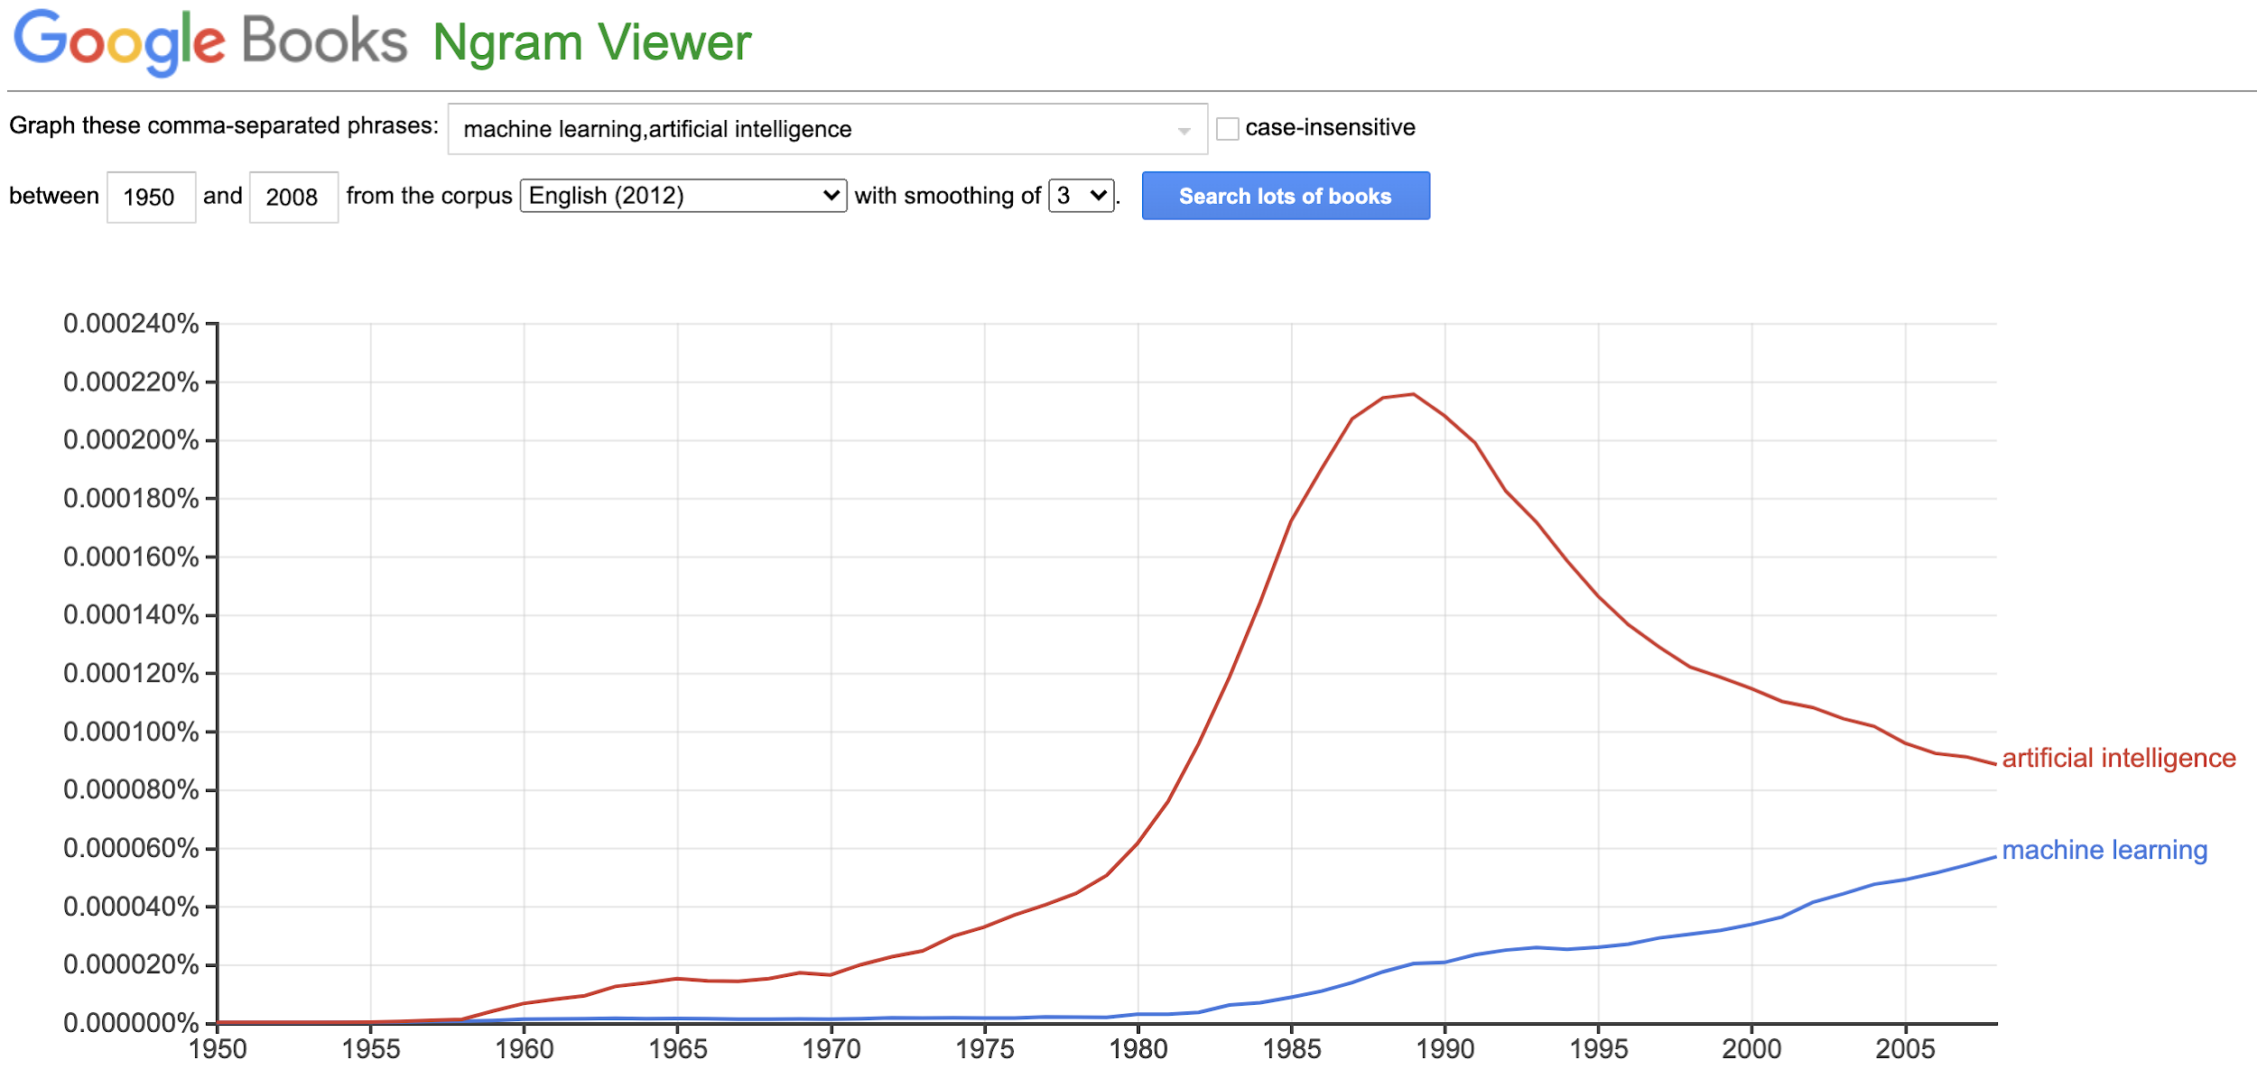
Notes:
I like to use Google Books ngram viewer to get some historical context. It also allows me to introduce the term ‘ngram’, which will come up later in the course when we apply ML to language. An ngram is just a sequence of n words that we treat as an unit for the sake of analysis. This plot here is formed by counting the number of times the terms ‘artificial intelligence’ and ‘machine learning’ appear in books published each year, divided by the count for all terms -- all ngrams with n between 1 and 5.
What does this show? Well, the whole field of AI went through a major boom and bust cycle (before the term ‘machine learning’ was popular). Early experiments in the 1960s translating Russian into English led to a lot of enthusiasm about forthcoming smooth-talking robots, until people realized that translation is actually much harder than looking up words in the dictionary. By the mid-1980s, major government funding was drying up, leading to this decades-long decline.
Meanwhile, small groups of academic researchers began applying long-studied statistical methods to the practical problems of interest to AI. How do you turn speech into text? What about that translation problem? Brains seems so good at these tasks and yet they don’t allow for easy inspection of their workings. This rebranding of statistics into computer science got the name ‘machine learning’, which began to catch on in the early 2000s, around when I was started graduate school (in 2006).

Slide 4
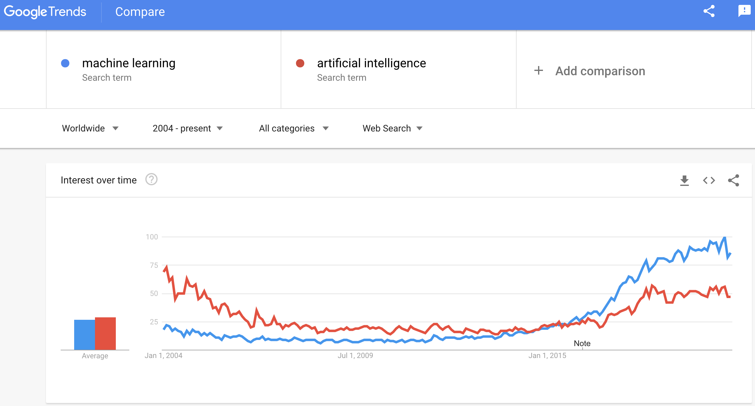
Notes:
So the books corpus hasn’t been updated, as far as I know, past 2008, so I’m switching over to Google Trends for search popularity over the last few decades. The books corpus -- all the data from books -- is somewhat different from the web search corpus -- all the data from web queries -- so we can’t just extend trend lines from books to web search.
Right around when I finished graduate school in 2011, something important happened. It’s not reflected immediately in this chart because it took a few years to start becoming more mainstream, to be reflected in actual search traffic. And that’s deep learning. That is, machine learning with neural networks. As is the case with most aspects of machine learning, neural networks were, relatively speaking, an ancient invention. Early computing pioneers in the 50s and 60s were responsible for most of the theoretical elements, back when a computer was programmed with punch cards and the hardware filled a room.
But in 2011, the convergence of large datasets, fast chips meant for graphics, and a few dedicated academics started getting breakthrough results in image and speech recognition. And here we are today, in the middle of perhaps a more moderate boom. Enthusiasm is no doubt high, but machine learning is now solving real problems really well.
My phone recognizes what I say, as long as I’m not at a noisy bar or speaking with a strong accent. Face detection works so well that we have reason to be concerned about the power of modern surveillance states. Ad targeting is apparently good enough to win elections. So indeed, machine learning and modern society are now overlapping in important ways.
We’d better understand what it’s all about.

Slide 5
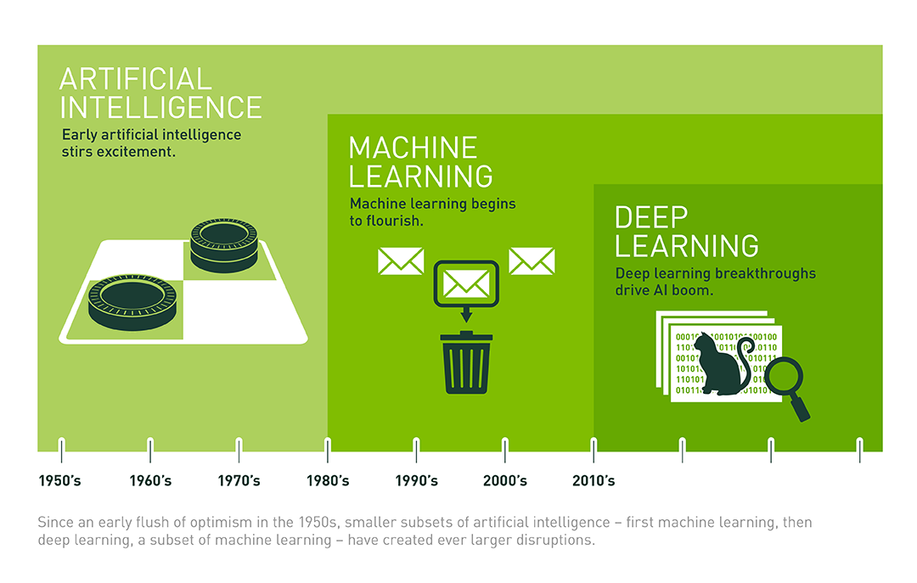
ML and AI
Artificial Intelligence
Decision making under uncertainty
Computational rationality
Machine Learning (ML)
Finding patterns in data
Learned functions
Source
Notes:
Ok, we looked at some ngram frequencies and talked about some history, but this still doesn’t tell us what computer scientists mean when they talk about machine learning and artificial intelligence.
Artificial intelligence is a general term that describes rational decision-making under uncertainty -- that is, making predictions.
Will it rain tomorrow? Who will win the cricket match? What sequence of actions should I take to navigate from home to the grocery store?
In addition, AI implies a computational framework for making these predictions.
A more accurate term for ‘artificial intelligence’ would be something like ‘computational rationality’. Making rational predictions based on math.
So what about machine learning?
Machine learning is essentially a sub-field of AI. It’s a particular, statistical approach to solving the problems posed by AI.
And deep learning is a sub-field of machine learning. It’s a particular approach to machine learning that uses neural networks.
One definition that’s often given for ‘machine learning’ involves ‘pattern recognition’, a term that comes from it’s statistical roots.
Ok so what is ‘pattern recognition’? That sounds a bit slippery, and indeed it is. As you’ll see, all kinds of predictions can be seen as pattern recognition.
More concretely, machine learning involves ‘learning functions’. Thinking in terms of functions -- inputs and outputs -- gives us a useful framework for understanding how to apply the tools of machine learning.
This approach has been so successful that in practice, machine learning has expanded to cover most of AI, and for that matter, deep learning has expanded to cover most of machine learning.
Let’s talk about some examples.

Slide 6
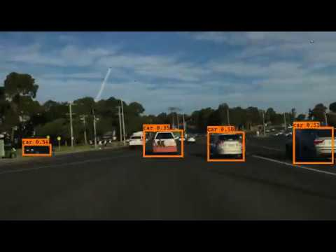
Autonomous Driving
Notes:
In this video, we’re watching how a self-driving car sees the world. A front-facing camera is collecting video frames, which are passed to a system that identifies relevant objects (like cars -- orange, trucks -- purple, traffic lights -- blue, people -- red) and draws bounding boxes around them.
The system responsible for these predictions (you can make out some of the probabilities) was trained using machine learning, from a large corpus (dataset) of images labeled with cars, trucks, traffic lights, people, etc.

Slide 7
Autonomous Driving
Object identification
Object detection
Object tracking/prediction
Route planning
Fully autonomous driving
Notes:
Let’s consider some of the tasks the self-driving car needs to solve, roughly in order of difficulty.
One is object identification. Assuming you are given that box around a particular object, you need to decide if it’s a car, a truck, a person, etc.
Second is object detection. Given a full image, we need to try to draw those bounding boxes.
Third is object tracking and prediction. While our data is made up of individual frames, they are connected through time. This is useful information! We actually want to track objects over time and try to predict where they will go. Is a car about to change lanes? Is that person crossing the street in front of me?
Fourth is route planning. Now things are getting complicated. We want to actually get somewhere specific, which involves continuous predictions of actions that take us to our destination.
Fifth is fully autonomous driving, which involves even more considerations about rules of the road.

Slide 8
Autonomous Driving
Artificial Intelligence
Object identification
Object detection
Object tracking/prediction
Route planning
Fully autonomous driving
Notes:
All of these tasks fit under the umbrella of Artificial Intelligence. That is, we’d like some computational strategy for coming up with rational predictions. But machine learning gives us a tighter framework for how to tackle these tasks -- by thinking in terms of learned functions, of inputs and outputs.

Slide 9
Autonomous Driving
Object identification | Image → Label
Object detection | Image → Object bounding boxes
Object tracking/prediction | Video → Moving bounding boxes
Route planning | Video, Map, Coordinates → Actions
Fully autonomous driving | Video, Map, Coordinates, Ethics, … → Actions
Notes:
Now let’s be more concrete, formulating these tasks with inputs and outputs. We’ll ask ourselves this question a lot: what are the inputs and what are the desired outputs?
…

Slide 10
Autonomous Driving
Classical Machine Learning
Object identification | Image → Label
Object detection | Image → Object bounding boxes
Object tracking/prediction | Video → Moving bounding boxes
Route planning | Video, Map, Coordinates → Actions
Fully autonomous driving | Video, Map, Coordinates, Ethics, … → Actions
Notes:
Earlier, I mentioned pattern recognition. Predicting the type of object from an image of an object fits cleanly in our notion of pattern recognition. How do we know this is an image of person rather than a truck? Well, we might recognize some facial features or some typical arm or leg forms. We will train systems that look for these identifying patterns that distinguish among the various possible classes.
And thus this object identification problem is a classical machine learning problem. But we can also extend our notion of pattern recognition to cover the more complex cases here. Route planning, for example, involves predicting a sequence of actions (rather than an individual label) given a video -- a sequence of images. This ‘input image sequence’ to ‘output prediction sequence’ certainly involves more complicated patterns.
By thinking of all these tasks in terms of inputs and desired outputs, we cast them all as machine learning. The kinds of functions we need, to learn these relationships will get more complicated, but we’ll deal with that later.

Slide 11
Supervision
Supervised learning (inputs, labels)
Unsupervised learning (inputs)
Reinforcement learning (inputs, eventual rewards)
Notes:
Ok, I’ve over-simplified. Defining machine learning is actually pretty hard. What I’ve really done is define “supervised learning”, which is the primary focus of this course. This is the case where, as I said, we want to learn a function that takes inputs and makes predictions of the desired outputs. In order to do this learning, we need examples of inputs and corresponding labels (which we will learn to predict).
Unsupervised learning deals with the case where we have “unlabeled data” -- that is, inputs but no labels. We can’t do supervised learning because the labels were our supervision. So are we stuck? Well, not completely. We can still look for patterns in the inputs. We can still cluster similar inputs close together, learning something about the underlying structure of the data. For example, if you had a big pile of images of cats and dogs, even if they had no labels, you might be able to learn that there were 2 clusters. You wouldn’t be able to attach a name like ‘cat’ to cluster number 1, but you’d still have learned something of value.
Finally, reinforcement learning involves a particular kind of indirect supervision. When a child points to a small dog and says ‘cat’, and her mother corrects her saying ‘no that’s a dog’, this is like supervised learning. But when a child is learning to crawl, she doesn’t have anyone confirming or denying each small muscle movement. Instead, if she manages to make a bit of forward progress, reaching a block or some food, this reward serves as a bit of indirect feedback. Her brain needs to connect this positive feedback back to the successful movements. Reinforcement learning is a computational framework for applying this idea. It’s very cool, but beyond the scope of this course.
In many ways, supervised learning is at the heart of all modern machine learning. And much of unsupervised and reinforcement learning, in practice, amounts to cleverly converting these problems to supervised learning, where our tools work much better. So it’s best to start there.

Slide 12
Machine Learning and Artificial Intelligence

Slide 13
Course Overview

Slide 14
Machine Learning Is Going Mainstream
“Data is the new oil.”
“AI is the new electricity.”
“Privacy is the new luxury.”
“Machine learning is the future.”
Notes:
I mentioned the hype around machine learning. I certainly did not imagine, back when I was starting to study this field in grad school, that I’d see cover stories in the New York TImes and the Economist, features on CNN and NPR declaring that ‘data is the new oil’ or ‘AI is the new electricity’, alternately touting and demonizing something I saw at the time as basically math.
Now, professors in this field have hundreds of thousands of followers on Twitter. The machine learning subreddit just passed 1 million members! The estimated worldwide market size for machine learning (though I can’t say I know exactly what that means), is over $10 billion.
Whether data is like oil or not, machine learning is growing increasingly important to the economy and to our lives. By studying it, you are taking a more active role in shaping this future, and that comes with some responsibility.

Slide 15
Course Goals
Practical introduction to the machine learning field
Building blocks and theory of neural networks
Useful programming tools (including Tensorflow)
Learn how to stay current as the field changes
Notes:
Our course goals are more practical. I’m hoping that you’ll become practitioners of machine learning, and assuming that you’ll mostly use existing tools in your work, rather than write completely new ones.
Over the past decade, nearly all supervised learning has shifted to use neural networks, so we’ll focus our efforts there.
Of course, it would be educational to code neural network training from scratch, but it would get quite involved and the existing tools are so useful that I think you’ll be better served learning the basics of Tensorflow. And don’t worry, we’ll write code for some of the basic building blocks like gradient descent.
Along these lines, this will not be a rigorous mathematical course. There will be some math, and it will be useful to review some basic calculus, linear algebra, and statistics, but I will favor giving mathematical intuition rather than deriving formulas and discussing proofs and computational bounds.
There are certainly courses that cover machine learning in much more mathematical depth, and if you decide to pursue a PhD or want to do research in this field, I’d suggest such a course.
Finally, it’s important to learn to stay current in this field because things keep changing. I imagine some of these lectures will again be out of date in a few years. Luckily, reading technical papers is not as intimidating as it may sound. Publications in computer science in general, and particular machine learning, are short -- usually 4-8 pages, and should include background and related work. They describe an idea, show some experiments, and discuss the results. Once you get familiar with the language and some of the standard tasks, they’ll feel pretty readable. We’ll get some practice in class.

Slide 16
Python Notebooks
Weekly notebooks are the interactive textbook of this course
Options for running the code
Run locally using Jupyter (need to install libraries)
Run using Google’s Colab (everything is installed)
Notes:
What about the structure of the course.
While I hope you will listen to my lectures, the best way to learn this material is by interacting with it. I’ve written a series of python notebooks that serve as an interactive textbook.

Slide 17
Course Work
Weekly notebook exercises
Final project
Small groups
Choose from approximately three Kaggle competitions
Run experiments
Write a summary report and present to class

Slide 18
Course Overview
Notes:
Q: What do you hope to get out of this course?

Slide 19
What Is a Function?
Notes:
I mentioned that machine learning, well, supervised machine learning, is about learned functions.
So let’s start by asking, what is a function?

Slide 20
What Is a Function?
Input
Function
Output
x
f(x)
y
Notes:
Well, it’s a box. It takes some input called x, applies some transformation called f(x), and produces some output called y.

Slide 21
What Is a Function?
Mapping between sets: for each input item, there is one corresponding output item.
Input
Function
Output
x
f(x)
y
X₁
X₂
X₃
X₄
Y₁
Y₂
Y₃
Notes:
Let’s be more mathematically precise. A function, technically, is a mapping between sets. For each input item there is one corresponding output item.
These sets can be very large, or indeed infinite. That is, they can include real-valued numbers.
They can be arbitrarily complex. They can include lists or sets or matrices.
An input X could be an image (represented as a 2-d array of pixel values) or a sequence of words in an email (represented as a 1-d array of vocabulary IDs).
An output Y could be a continuous value like a temperature or a true/false value or- another sequence of vocabulary IDs (perhaps corresponding to a translation of an email into a different language).
But importantly, while many items in X can map to one item in Y, we can’t go the other way. If one value of X maps to multiple values in Y, then we have some non-determinism and this is not a function.
For numerical inputs and outputs in a few dimensions, it’s easy to plot functions. For each value of X on the X axis, there’s some corresponding value of Y. But note that a circle, for example, is not a function! One value of X maps to 2 different values of Y.

Slide 22
Function Examples
Notes:
Ok, let’s talk about some examples.

Slide 23
Function Examples
add_six(number)
get_prime_factors(number)
upper_case(string)
convert_time(loc1, time, loc2)
is_it_raining(weather_report)
Notes:
So here are some examples of functions.
I think if I asked you to write code for these functions, you’d know how to do it.

Slide 24
Function Examples
add_six(number)
get_prime_factors(number)
upper_case(string)
convert_time(loc1, time, loc2)
is_it_raining(weather_report)
height_from_shoe_size(shoe_size)
is_cat(image)
is_positive_movie_review(text)
text_from_audio(audio)
will_it_rain_tomorrow(weather_report)
Notes:
What about these functions?
One thing you’ll note about these is that whereas the first column was deterministic, these are less so.
Can you determine a height from a shoe size? Can you be sure that an image contains a cat? There’s some subjectivity there.
Is a movie review positive or negative? That might be open to interpretation.
What words were spoken in some audio? There might be some ambiguity. What if there is background noise or multiple speakers?
And can you say whether it will rain tomorrow given a weather report? Well, you can venture a guess. But the best you can do is give it a probability.

Slide 25
Learned Functions (Models)
How would you write this function: height_from_shoe_size(shoe_size)
Notes:
So how would you go about writing a function to predict height from shoe size?
I guess I could write a function that deterministically always predicts 6’2. That’s my height. That is a function.
[Draw function]
But it’s not so useful. I could guess a relationship between shoe size and height.
[Draw function]
But that just a guess.
I really need some extra information to write a reasonable version of this function.

Slide 26
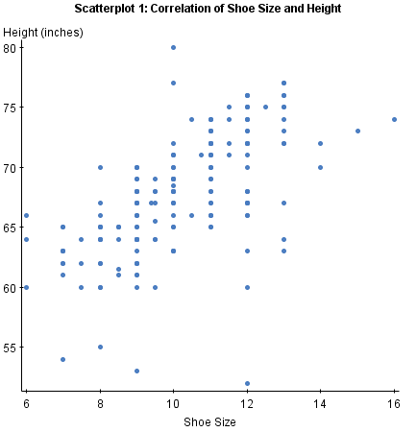
Learned Functions (Models)
How would you write this function: height_from_shoe_size(shoe_size)
Does this help?
Notes:
Ok, here’s some information that seems pretty useful. Each of these dots corresponds to a person.
By the way, is this data a function? We have inputs (shoe size) on the x axis and outputs (height) on the y axis.
But no! This is not a function because for shoe size, say, 10, there are many heights.

Slide 27
Learned Functions (Models)
How would you write this function: height_from_shoe_size(shoe_size)
Does this help?
Data
Input
Function
Output
x
f(x)
y
Notes:
We can use this data to help write our function.
And at this point, I’ll transition from talking about ‘writing’ functions, which is the programming paradigm you’re familiar with, to talking about ‘learning’ functions from data.
In machine learning, we refer to a learned function as a model.

Slide 28
What Is a Function?
Notes:
[True/False] A model is a learned function that predicts outputs y from inputs x.
A: True

Slide 29
Function Testing
Notes:
As conventional programmers, I hope you’re familiar with testing.
Remember that the idea is that you write some special code that tests the logic of the functions you’ve written, basically to makes sure you didn’t miss anything.

Slide 30
Function Testing
def add_six_test():
???
Notes:
For example, what might a test look like for the add_six function?
Well, we want to make sure it works, but we also want to check some edge cases.

Slide 31
Function Testing
def add_six_test():
assertEqual(add_six(-3), 3)
assertEqual(add_six(3), 9)
Testing logic
Check edge cases

Slide 32
Function Testing
def add_six_test():
assertEqual(add_six(-3), 3)
assertEqual(add_six(3), 9)
def height_from_shoe_size_test():
???
Testing logic
Check edge cases
Notes:
Ok, now what about a test for height from shoe size?
We can’t test it deterministically so the usual testing paradigm doesn’t fit.

Slide 33
Function Testing
def add_six_test():
assertEqual(add_six(-3), 3)
assertEqual(add_six(3), 9)
def height_from_shoe_size_test():
???
Testing logic
Check edge cases
Statistical testing
Check average performance
Notes:
Instead of testing logic, we want a kind of statistical test.
That is, we want to see how well it does at making predictions on average.

Slide 34
Evaluating Performance
Notes:
And to do that, again we need data.

Slide 35
Evaluating Performance
Need labeled examples
Size: 9, Height: 61
Size: 12, Height: 66
Etc.
Notes:
If we want to test average performance of our model, we need some labeled examples, in this case corresponding to actual people, their shoe sizes and their heights. For each input, the shoe size, the label tell us the actual height.

Slide 36
Evaluating Performance
Need labeled examples
Size: 9, Height: 61
Size: 12, Height: 66
Etc.
Compare function output (predictions) to labels
“Error” or “Loss” or “Cost”
Notes:
Then, we can compare the output of our model, the predictions, to the labels.
This gives us a quantitative measure of our performance, which is referred to sometimes as the ‘error’, the ‘loss’, or the ‘cost’.
[Draw model over data]

Slide 37
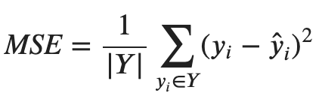
Evaluating Performance
Need labeled examples
Size: 9, Height: 61
Size: 12, Height: 66
Etc.
Compare function output (predictions) to labels
“Error” or “Loss” or “Cost”
Notes:
Here’s the formula for the ‘mean squared error’.

Slide 38
Function Testing
Notes:
Q: A loss function compares _____ to _____.
A: predictions, labels

Slide 39
Generalization
Notes:
In that last section on function testing, I left something out that’s quite important.
Remember when we talked about learning functions, I showed you the plot with all the shoe size and height data points -- the data that’s the key ingredient for learning.
And then, when we talked about testing learned functions, I showed you the same plot! Well, indeed we do need labeled data both for learning and for testing, but crucially, this cannot be the same data. Why?

Slide 40
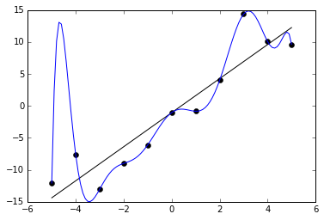
Predictions
Suppose the points are the labeled examples
Notes:
Suppose the points here are labeled examples we’re going to use for learning.
Note that I’ll use ‘learning’ and ‘training’ interchangeably.
We’ll assume as usual that the inputs are the X values and the outputs are the Y values.

Slide 41
Predictions
Suppose the points are the labeled examples
Are both black and blue lines possible models?
Notes:
Are both these lines, the straight black line and the wiggly blue line possible models?
Yes, they are both functions that predict an output Y value for each input X value

Slide 42
Predictions
Suppose the points are the labeled examples
Are both black and blue lines possible models?
Which is better?
Notes:
Now the key question- which is better?
Well, the blue line looks like a complicated polynomial function of X -- something like X^7 - 2.5X^6 … and it manages to go right through all labeled examples. That is, the blue model predicts all the training examples with no error.
The black line, on the other hand is linear in X. No polynomials here. This is nice and simple, but it does not go through all the labeled examples.
That is, the black model’s predictions on the train examples have some non-zero error.
This analysis is not sufficient to say which is better.

Slide 43
Predictions
Suppose the points are the labeled examples
Are both black and blue lines possible models?
Which is better?
How do they perform with some new data?
Notes:
The real question is, how well do they predict new data? After all, the whole purpose of training these models is to make predictions for new inputs. We want to predict the weather tomorrow, not yesterday.
That’s why it’s crucial to have data for testing that’s different from the data we used for training.
Suppose these red dots here are our test data (though in practice, 2 is almost certainly not enough).

Slide 44
The Train/Test Split
Models are useful for making new predictions
This is called generalization
Notes:
So to summarize, models are useful mostly for making new predictions.
This capability, to learn from some examples in a way that transfers to new examples, is called generalization.
Generalization is perhaps the single term that sums up the goal of supervised machine learning. We’ll be talking about it a lot.

Slide 45
The Train/Test Split
Models are useful for making new predictions
This is called generalization
Simulate this by splitting data into train and test
Could be a random split
Could depend on other properties of the data
Notes:
And the primary way we have to check this generalization is by splitting our labeled data into separate portions for training and testing.
By far the most common way to do this is with a random split.
Suppose we have data for 100 people -- their shoe sizes and heights. These are our labeled examples.
We might randomly assign these 100 examples to one of two buckets -- training or testing. Maybe put 80 examples in the train split and 20 in the test split.
As you’d expect, we’d train our model using the training examples, then evaluate -- compute the mean squared error, for example, on the test examples.
Remember that this process -- splitting labeled examples into buckets for training and testing -- is intended to simulate the way we want to use the model in practice. We want to know how well we should expect the model to work in… the wild.
That means that we need to treat our test data with the utmost respect. If we use it too much, testing model after model, we’ll end up unintentionally transmitting some information about the test data into our model design. Then we’re not learning to generalize anymore -- we’re learning to cheat.

Slide 46
The Train/Test Split
Models are useful for making new predictions
This is called generalization
Simulate this by splitting data into train and test
Could be a random split
Could depend on other properties of the data
Blue model is an example of overfitting
Notes:
Let’s return to the two models here. As we discussed, the black model is preferable to the blue model because performance, as measured by MSE on the test data, is better.
Is there anything else we can say about these two models and what went wrong with the blue one?
Yes, there’s the principle of Occam’s Razor. That is, all things being equal, the simpler explanation is the better one.
The black model is simpler -- mathematically, it has fewer learned parameters -- just an intercept and a slope.
The blue model is an example of overfitting, another term we’ll use frequently. It has learned to fit the training data too well, at the expense of generalization.
Generalization, as you will see, involves a fundamental trade-off: we want to fit the training data since afterall, that’s what we have to go on; but we don’t want to fit it so well that we just memorize it.

Slide 47
Generalization
Notes:
Q: [True/False] Test data is useful for assessing generalization.
A: True

Slide 48
Machine Learning Framing
Notes:
Ok, I think we’ve introduced all the key ingredients, well abstract ingredients, for machine learning. We have a lot of details to get to.

Slide 49
Summary So Far
You’re already familiar with logical functions
Outputs are typically deterministic
Testing is logical and typically checks extreme cases
ML is about learning statistical functions from data
Outputs are predictions
Testing is statistical and typically checks average case
ML depends on labeled data
Behavior of the model reflects the data
Need separate test data to evaluate generalization
Notes:
Let’s summarize.

Slide 50
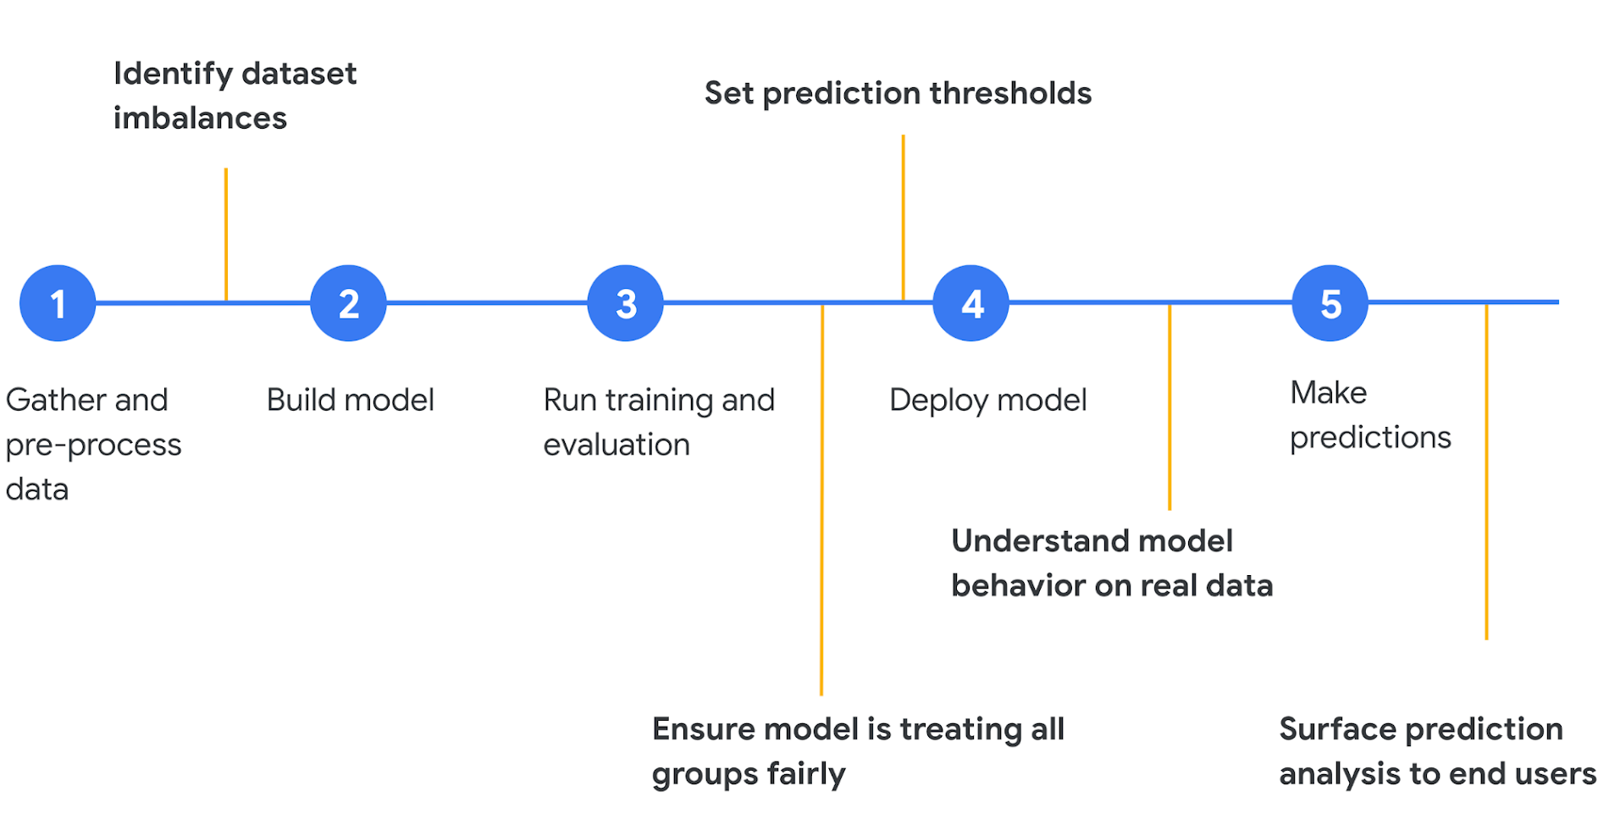
Machine Learning Framing
Google Cloud
Notes:
Now let’s put some of this in context. Machine learning is not just about training fancy neural network functions.
It’s part of a larger process that’s summarized in this diagram.

Slide 51
Machine Learning Framing
Google Cloud
Notes:
We’ve discussed (a little bit) training and evaluation in the middle here.
But usually, machine learning doesn’t actually start with a task, it starts with a question about data. What kind of data do we have? What are the labels?

Slide 52
Framing: Defining a Task
What are the inputs and outputs?
What is the labeled data?
How will you evaluate predictions?
Considerations for train/test split?
How will your function be used?
What is a baseline predictor?
Notes:
So here’s a set of questions that I think we should always ask ourselves as we define a task that we want to address with machine learning. They help us frame our thinking.
Quite often, when I teach this class, students want to begin with task. I want to use machine learning to diagnose depression, or score reading/writing level, or improve speech recognition for accents, for example. And these are all great tasks. But because we’re doing supervised learning, we need to start with the data. The inputs and outputs. We need to be very concrete about what exactly we’re going to predict and how we’ll evaluate those predictions with respect to labeled data.
...

Slide 53
Machine Learning Framing
Notes:
Q: [True/False] A baseline should help ground expectations for modeling experiments.
A: True

Slide 54
Lung Cancer Screening
Example One

Slide 55
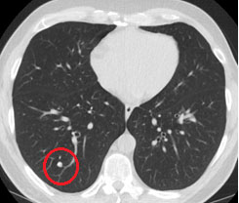
Lung Cancer Screening
What are the inputs and outputs?
What is the labeled data?
Considerations for train/test split?
How will your function be used?
How will you evaluate predictions?
What is a baseline predictor?
Google

Slide 56
What are the inputs and outputs?
Input: CT images
Output: cancer probability
Output: image regions and probabilities
Google

Slide 57
What is the labeled data?
Scans annotated by human experts
Google
Notes:
Multiple experts
Agreement?

Slide 58
Considerations for train/test split?
No patient with scans in both train and test
Google

Slide 59
How will your function be used?
By doctors
By patients
By insurance companies
Does training population match usage population?
Google

Slide 60
How will you evaluate predictions?
Classification accuracy
Correct / Total
Mistakes have 2 types
False positives
False negatives
Calibration
Google

Slide 61
What is a baseline predictor?
Always predict ‘no cancer’
Google

Slide 62
Lung Cancer Screening
Notes:
Q: [True/False] Training data population in unlikely to cause bias in the classifier
A: False

Slide 63
Sports Outcomes
Example Two

Slide 64
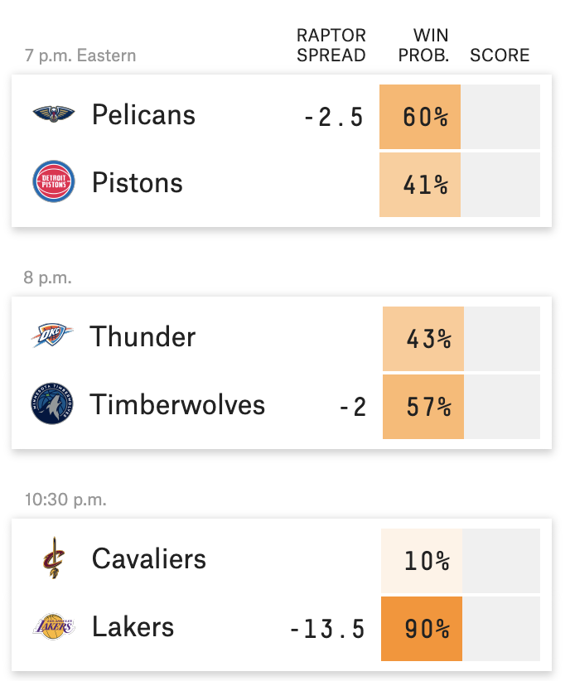
Basketball Predictions
What are the inputs and outputs?
What is the labeled data?
Considerations for train/test split?
How will your function be used?
How will you evaluate predictions?
What is a baseline predictor?
FiveThirtyEight

Slide 65
What are the inputs and outputs?
Inputs: team1 and team2
Outputs: win/loss
Outputs: point difference
FiveThirtyEight

Slide 66
What is the labeled data?
Previous games and results (from the current season)
FiveThirtyEight

Slide 67
Considerations for train/test split?
Use past games to predict future results (rolling predictions)
FiveThirtyEight

Slide 68
How will your function be used?
Gambling: setting lines
FiveThirtyEight

Slide 69
How will you evaluate predictions?
Accuracy
MSE
FiveThirtyEight

Slide 70
What is a baseline predictor?
Team win/loss records
FiveThirtyEight

Slide 71
Sports Outcomes
Notes:
Q: [True/False] As described, these prediction models are useless for the first game of a new season.
A: True

Slide 72
Energy Usage
Example Three

Slide 73
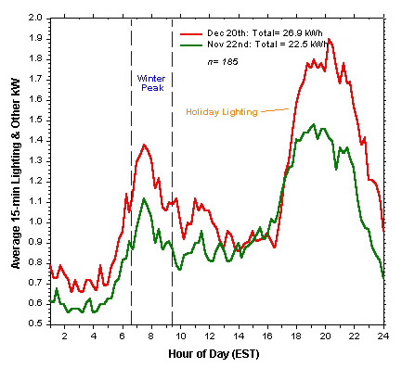
Energy Usage
What are the inputs and outputs?
What is the labeled data?
Considerations for train/test split?
How will your function be used?
How will you evaluate predictions?
What is a baseline predictor?
FSEC

Slide 74
What are the inputs and outputs?
Inputs: date, time, weather (15-minute intervals)
Outputs: energy usage
FSEC

Slide 75
What is the labeled data?
Previous observations
FSEC

Slide 76
Considerations for train/test split?
Rolling predictions
FSEC

Slide 77
How will your function be used?
Coordinating mixture of power sources
FSEC

Slide 78
How will you evaluate predictions?
MSE
FSEC

Slide 79
What is a baseline predictor?
Average usage
FSEC

Slide 80
Review
What is a function?
What is a model?
What is meant by generalization?
What is overfitting?
Why do we need a train/test split?
Why do we want a baseline?

Slide 81
Energy Usage
Notes:
Q: [True/False] A model trained with data from San Francisco should work well for other similarly sized cities.
A: False

